Slide 1
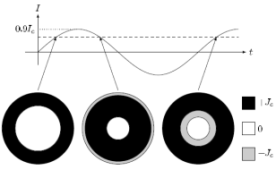
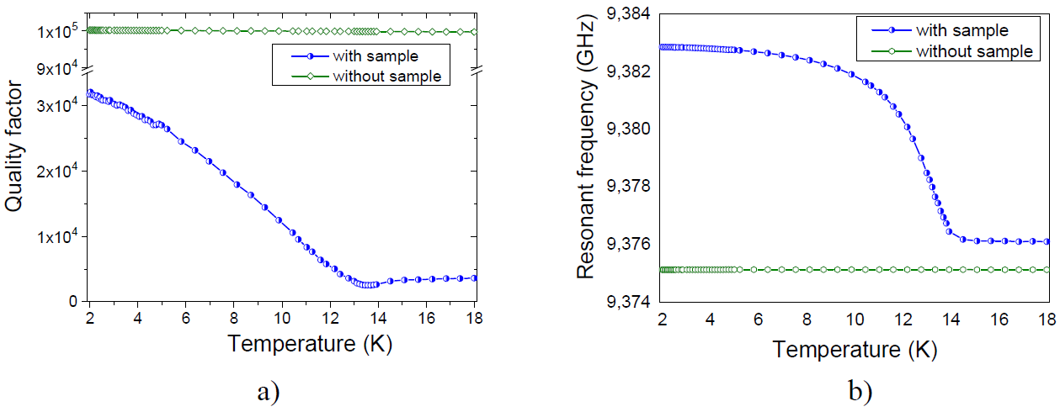
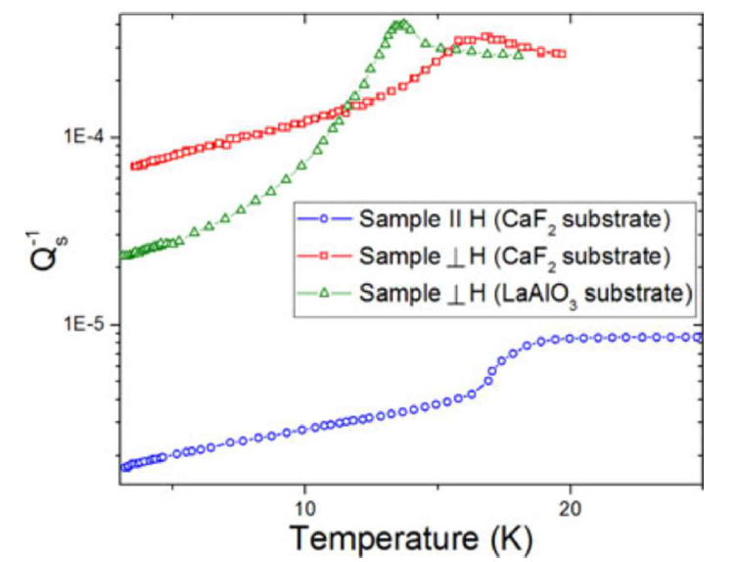
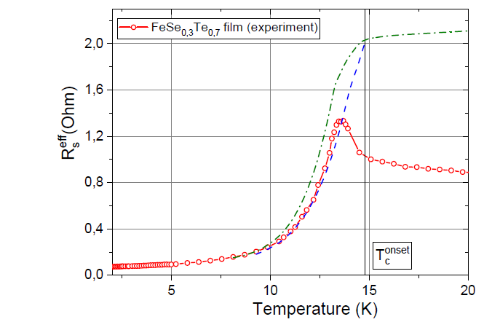
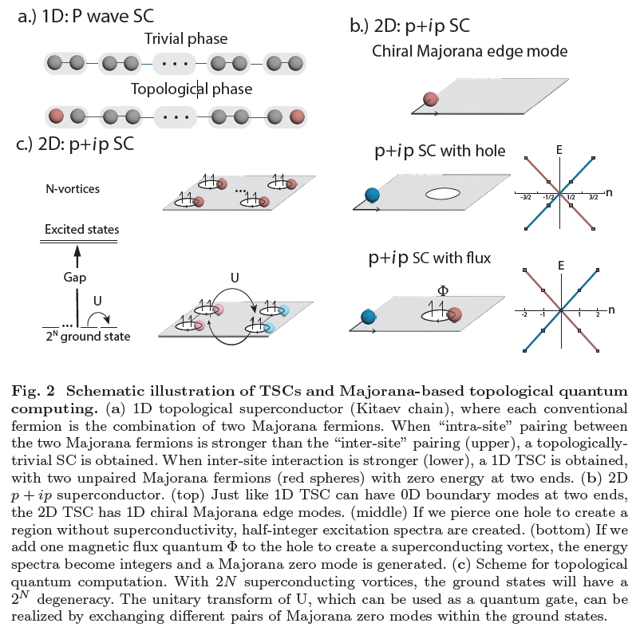
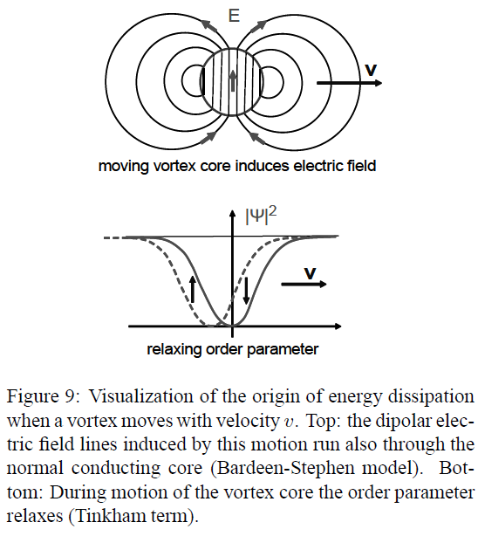
Features of vortex dynamics in the description of microwave absorption by a thin HTSC disk
S. I. Melnyk, N. T. Cherpak
O.Ya. Usikov Institute for Radiophysics and Electronics NAS of Ukraine melnyksergiy72@gmail.com
The obtained results of the analysis are of particular interest in connection with the previously discovered strange feature of the response of the thin FeSe1-xTex film in a perpendicular MW field [3]. It is completely absent for a parallel orientation of the film. And, most surprisingly, this feature manifested itself only in the films of FeSe1-xTex superconductors and did not manifest itself in the films of other type II superconductors. It was hypothesized that with perpendicular orientation, two competing mechanisms of MW energy dissipation in the film may take place, one of which leads to an increase in energy dissipation caused by magnetic vortices with the MW field, and the other to a decrease due to the emergence of Majorana bound states with zero energy [4].
The study of the dynamics of the vortex structure caused by the action of the perpendicular alternating magnetic fields on high-temperature superconductor (HTS)-based film structures has a long history. The most complete review of the models used for this and an analysis of their compliance with the experimental results obtained is given in [1].
All existing models, one way or another, are generalizations of the phenomenological Bean model, in which the mechanism of the emergence and movement of vortices is not considered. In fact, this implies a quasi-stationary state of the vortex structure, which adequately describes the dynamics of the distribution of the magnetic field up to frequencies of about 100 kHz.
Fig. 1. Temperature dependence of $Q⊥$ (a) and frequency $f⊥$(b) of the resonator with FeSe1-xTex (х=0.7) film at the $⊥$orientation of the film in the MW magnetic field of the resonator. The temperature dependences of the Q-factor (a) and the frequency f (b) of the resonator without a film, but with a dielectric substrate, are also presented.
Fig. 2. Temperature dependence of the inverse Q-factor of the resonator (decrement) with FeSe1-xTex film for the ⊥ orientation (x = 0.5 and 0.7) and for the ∥- orientation (x = 0.5).
Fig. 3. Temperature dependence of the effective surface resistance of the FeSe1-xTex film with ⊥ orientation; 0 -${{ R}_{S⊥}}^{eff} (T)$, dashed line -${{ R}_{S⊥0}}^{eff} (T)$, dash-dotted line - ${{\tilde{R}}_{S⊥}}^{eff} (T)$
2. In this regard, the applicability of the obtained results to the MW range is questionable. Models of absorption of the microwave (MW) field by a vortex structure formed by an additional large constant magnetic field have also been analyzed in sufficient detail [2]. They consider the absorption mechanism associated with the oscillatory motion of pinned or free vortices, the distribution of which is specified by a large constant component of the field.
However, in the case of only MW action of perpendicular orientation on a thin HTSC disk, the vortices do not have time to move over sufficiently large distances, and the dynamics of their radial distribution is apparently associated with reorientation or annihilation mechanisms. We analyzed the correspondence of this hypothesis and the Bean model, and developed a corresponding numerical model.
The hypothesis of the influence of the presence of Majorana 0-modes
on the nature of energy dissipation in a thin superconducting disk in a MW field is mainly associated with a change in the parameter |𝜓|^2 with a periodic change in the vortex distribution density.
When Majorana zero modes arise in a vortex structure, the quantum states of Cooper pairs that form a Majorana pair of spatially distant vortices with different directions of magnetic flux in them change their quantum state in a coordinated manner [7].
Such a mechanism for changing the vortex density distribution (in accordance with the Bean model) does not lead to energy dissipation, which can be interpreted as the appearance of an additional term of partial "return" of dissipation energy, compared to the classical mechanism.
3. Usually [5,6] consider only two mechanisms of energy dissipation in the 2nd kind of NP, associated either with the flow of current through the vortex core, or due to the vortex motion.
A moving vortex core means that at a given position the order parameter |𝜓|^2 decreases and increases again. If we assume a delay in the recovery of |𝜓|^2 for the relaxation time $τ≈ℏ/∆≈(300 GHz)^(−1),$we obtain additional order dissipation.
At ultrahigh frequencies, the estimates give a very small vortex displacement per period. Therefore, the mechanism of establishing a new distribution of vortices with the opposite direction of the magnetic field is associated with their "reversal" (or sequential destruction and creation of new ones).
In this case, the order parameter remains in place, but its oscillations occur. The energy dissipation in this process can be described in the same way as in the motion of vortices.
The work was performed within the framework of Agreement No 4.5/25-Π on Jan. 1, 2025 between National Academy of Sciences (NAS) of Ukraine and O. Ya. Usikov IRE of NAS of Ukraine.
[1] Thin superconducting disk with B-dependent Jc : Flux and current distributions D. V. Shantsev, Y. M. Galperin, and T. H. Johansen Phys. Rev. B, v.60, p.13112-13118 (1999) arXiv:cond-mat/9906297v1
[2] Dobrovolskiy, O. (2024). Fast Dynamics of Vortices in Superconductors. In T. Chakraborty (Ed.), Encyclopedia of Condensed Matter Physics (Vol. 2, pp. 735-754). Elsevier. https://doi.org/10.1016/B978-0-323-90800-9.00015-9
[3] Y. Wu, A. A. Barannik, L. Sun, Y.-S. He, N. T. Cherpak, The unusual microwave response of chalcogenide FeSe1-xTex film compared to other superconductors, Condensed Matter & Low Temperature Physics: II Intern. Advanced Study Conference. June 6 12 2021
[4] Possible manifestation of topological superconductivity and Majorana bound states in the microwave response of thin FeSe1-xTex film NT Cherpak, AA Barannik, YS He, L Sun, Y Wu, SI Melnyk. arXiv preprint arXiv:2312.11155, 2023 arxiv.org
[5] M. Tinkham, Phys. Rev. Lett. 13 (1964) 804.
[6] Electrodynamics of superconductors exposed to high frequency fields EH Brandt arXiv preprint arXiv:1008.2231, 2010
[7] Topological Superconductors from a Materials Perspective† Manasi Mandal, Nathan C. Drucker, Phum Siriviboon, Thanh Nguyen, Artittaya Boonkird, Tej Nath Lamichhane, Ryotaro Okabe, Abhijatmedhi Chotrattanapituk, and Mingda Li Chemistry of Materials 2023 35 (16), 6184-6200 DOI: 10.1021/acs.chemmater.3c00713

